Slide 1
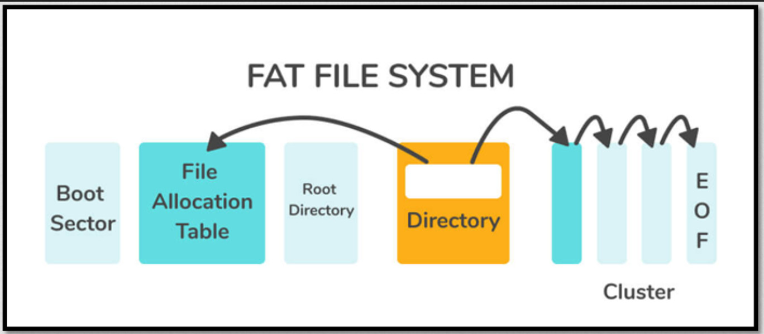

Slide 2
Kiểu FAT (FAT12/FAT16/FAT32) được quyết định dựa trên số cluster của ổ đĩa luân lý, ngoài ra không có cách định nào khác.
Số cluster ở đây là số lượng cluster có ở vùng Data, hay nói cách khác là giá trị mà kích thước vùng Data chia cho kích thước cluster.
CountofClusters = DataSectors / BPB_SecPerClus;
FAT | Số bít để đếm | Dung lượng | Số Cluster | Đặc điểm
FAT12 | 12 | ～128M Byte | <4 085 (~2^12) | Số lượng cluster thấp.
FAT16 | 16 | 2M～2G Byte | ≥4 086 và ≤6 5526 | Với hệ điều hành MS-DOS
FAT32 | 32 | 32M～2T Byte | >65 526 (~2^16) | Được biết đến từ Windows 95 Service Pack 2

Slide 3
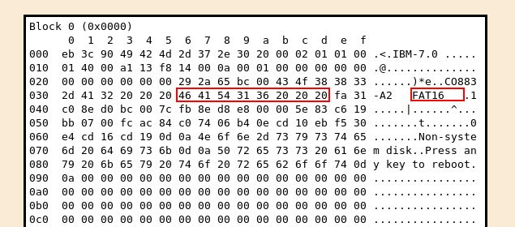
Area description | Area size | Number of block (512 bytes)
Boot block (Boot Sector) | 1 block | 1 byte
File Allocation Table (may be multiple copies) | Depends on file system size | = Number of File Allocation Tables (0x10 in Boot block) x The number of blocks occupied by one copy of the File Allocation Table (0x17 0x16 in Boot block). 00 14 (hex) = 20 (dec)
Disk root directory | Variable (selected when disk is formatted) | Number of root directory entries (including unused ones). (0x12 0x11 in Boot block). 00 04 (hex) = 4 (dec)
File data area | The rest of the disk

Slide 4
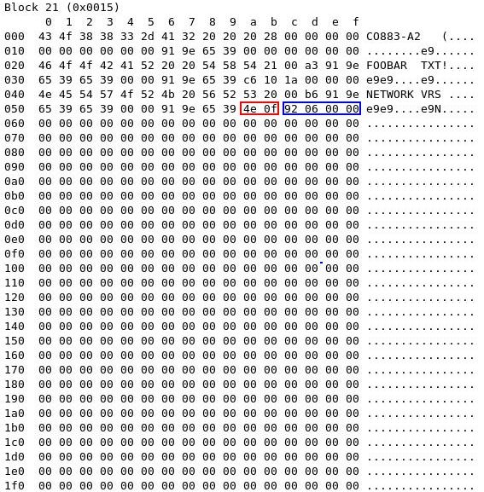
Source text
The format of all directories is the same. Each entry is 32 bytes (0x20) in size, so a single block can contain 16 (=512/32) of them. The following table shows a summary of a single directory entry; note that the offset is merely from the start of that particular entry, not from the start of the block.
Offset | Length | Description
0x00 | 8 bytes | Filename | NETWORK
0x08 | 3 bytes | Filename extension | 56 52 53 = VRS
0x0b | 1 byte | File attributes | 20 = space
0x0c | 10 bytes | Reserved | 00 b6 91 9e 65 39 65 39 00 00
0x16 | 2 bytes | Time created or last updated | 9e 91 1001 1110 1001 0001
0x18 | 2 bytes | Date created or last updated | 39 65 0011 1001 110 0101
0x1a | 2 bytes | Starting cluster number for file | 0f 4e = 3918 (dec)
0x1c | 4 bytes | File size in bytes | 06 92 = 1682 byte (dec)
1-st entry
2-nd entry
3-rd entry
56 52 53 = VRS

Slide 5
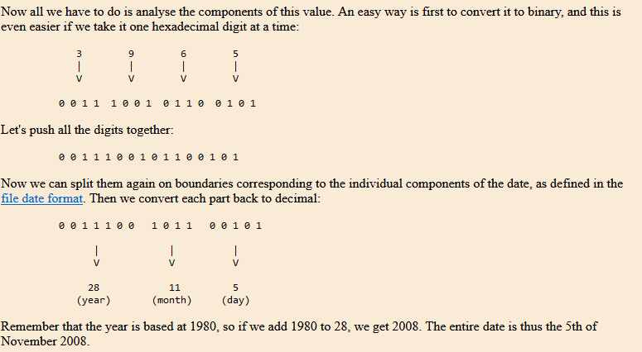
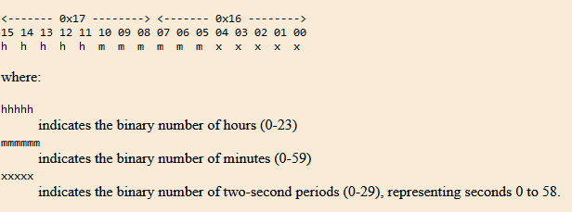
TIME CREATED OR LAST UPDATED
DATE CREATED OR LAST UPDATED
0x16 | 2 bytes | Time created or last updated | 0x17 0x16 9e 91 1001 1110 1001 0001
0x18 | 2 bytes | Date created or last updated | 0x19 0x18 39 65 0011 1001 110 0101
Time created or last updated
1001 1110 1001 0001
10011 110100 10001 hhhhh mmmmmm xxxxx 19 : 52 : 17

Slide 6
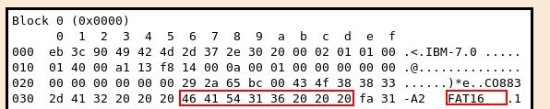
Bắt đầu
Open file FAT
Read bytes: 0x39..0x3d
Kiểm tra FAT12, 16 hay 32?
N
Tính số SECTOR trong Root Directory
=MAX Number of root directory entries (0x12 0x11 in Boot Block) *32 bytes /512 bytes
Error
Y
Gọi Hàm Đọc file FAT tương ứng
Đọc các biến cần trong Boot Block
Tính số block của
Boot block và FAT
1 block + …
Trỏ tới vị trí đầu của
Disk root directory

Slide 7
Offset from start | Length | Description
0x00 | 3 bytes | Part of the bootstrap program.
0x03 | 8 bytes | Optional manufacturer description.
0x0b | 2 bytes | Number of bytes per block (almost always 512).
0x0d | 1 byte | Number of blocks per allocation unit.
0x0e | 2 bytes | Number of reserved blocks. This is the number of blocks on the disk that are not actually part of the file system; in most cases this is exactly 1, being the allowance for the boot block.
0x10 | 1 byte | Number of File Allocation Tables.
0x11 | 2 bytes | Number of root directory entries (including unused ones).
0x13 | 2 bytes | Total number of blocks in the entire disk. If the disk size is larger than 65535 blocks (and thus will not fit in these two bytes), this value is set to zero, and the true size is stored at offset 0x20.
0x15 | 1 byte | Media Descriptor. This is rarely used, but still exists. .
0x16 | 2 bytes | The number of blocks occupied by one copy of the File Allocation Table.
0x18 | 2 bytes | The number of blocks per track. This information is present primarily for the use of the bootstrap program, and need not concern us further here.
0x1a | 2 bytes | The number of heads (disk surfaces). This information is present primarily for the use of the bootstrap program, and need not concern us further here.
0x1c | 4 bytes | The number of hidden blocks. The use of this is largely historical, and it is nearly always set to 0; thus it can be ignored.
0x20 | 4 bytes | Total number of blocks in the entire disk (see also offset 0x13).
0x24 | 2 bytes | Physical drive number. This information is present primarily for the use of the bootstrap program, and need not concern us further here.
0x26 | 1 byte | Extended Boot Record Signature This information is present primarily for the use of the bootstrap program, and need not concern us further here.
0x27 | 4 bytes | Volume Serial Number. Unique number used for identification of a particular disk.
0x2b | 11 bytes | Volume Label. This is a string of characters for human-readable identification of the disk (padded with spaces if shorter); it is selected when the disk is formatted.
0x36 | 8 bytes | File system identifier (padded at the end with spaces if shorter). (Type of FAT: FAT 12, 16, 32)
0x3e | 0x1c0 bytes | The remainder of the bootstrap program.
0x1fe | 2 bytes | Boot block 'signature' (0x55 followed by 0xaa).

Slide 8
Note: chỉ được phép gọi tử tâng trên cho tầng dưới -Không được phép gọi ngược hàm nếu gọi ngược thì phải sử dụng CALLBACK Functionc
MAIN chứa tham số duy nhất là Fath_file đĩa mềm
App
Chứa các tính năng yêu cầu của ứng dụng
Middleware
Handle FATs
Display
HAL_FATS
Tương tác với tầng vật lý

Slide 9
HAL_FATS_ENUM_ERROR_Type HAL_FATS_Open_Floppy_Disk(uint8_t* Path_File)
TẦNG 1:TƯƠNG TÁC VẬT LÝ
int32_t HAL_ReadSector(uint32_t index, uint8_t *buff)
HAL_FATS
int32_t HAL_ReadMultiSector(uint32_t index, uint32_t num, uint8_t *buff)
HAL_FATS_ENUM_ERROR_Type HAL_FATS_Close_Floppy_Disk(void)

Slide 10
TẦNG 2: CÁC TÍNH NĂNG ỨNG DỤNG
MIDDLE_WARE
OPERATION FATS
Fat_init
OPERATION Display Screen
BOOTSECTOR
Read file
READ_Root_Directory
Display
READ_FILE
READ_FOLDER
READ_ATTRIBUTE
CLOSE_FILE

Slide 11
BOOTSECTOR

